Slide 1
A utilization of Machine Learning
By: Xavier Ruiz
Add def. Prof. says

Slide 2
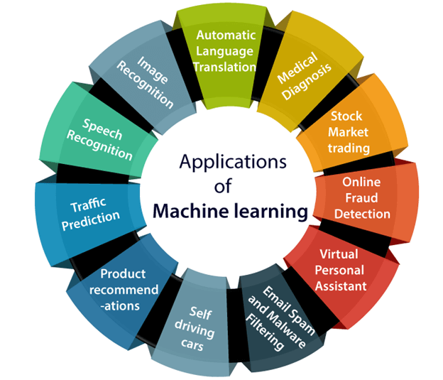
Many Forms
Versatile
Used in a numerous amount of programs
Refinement
Automatic
Identifies trends/similar patterns
Machine learning is NOT AI!

Slide 3
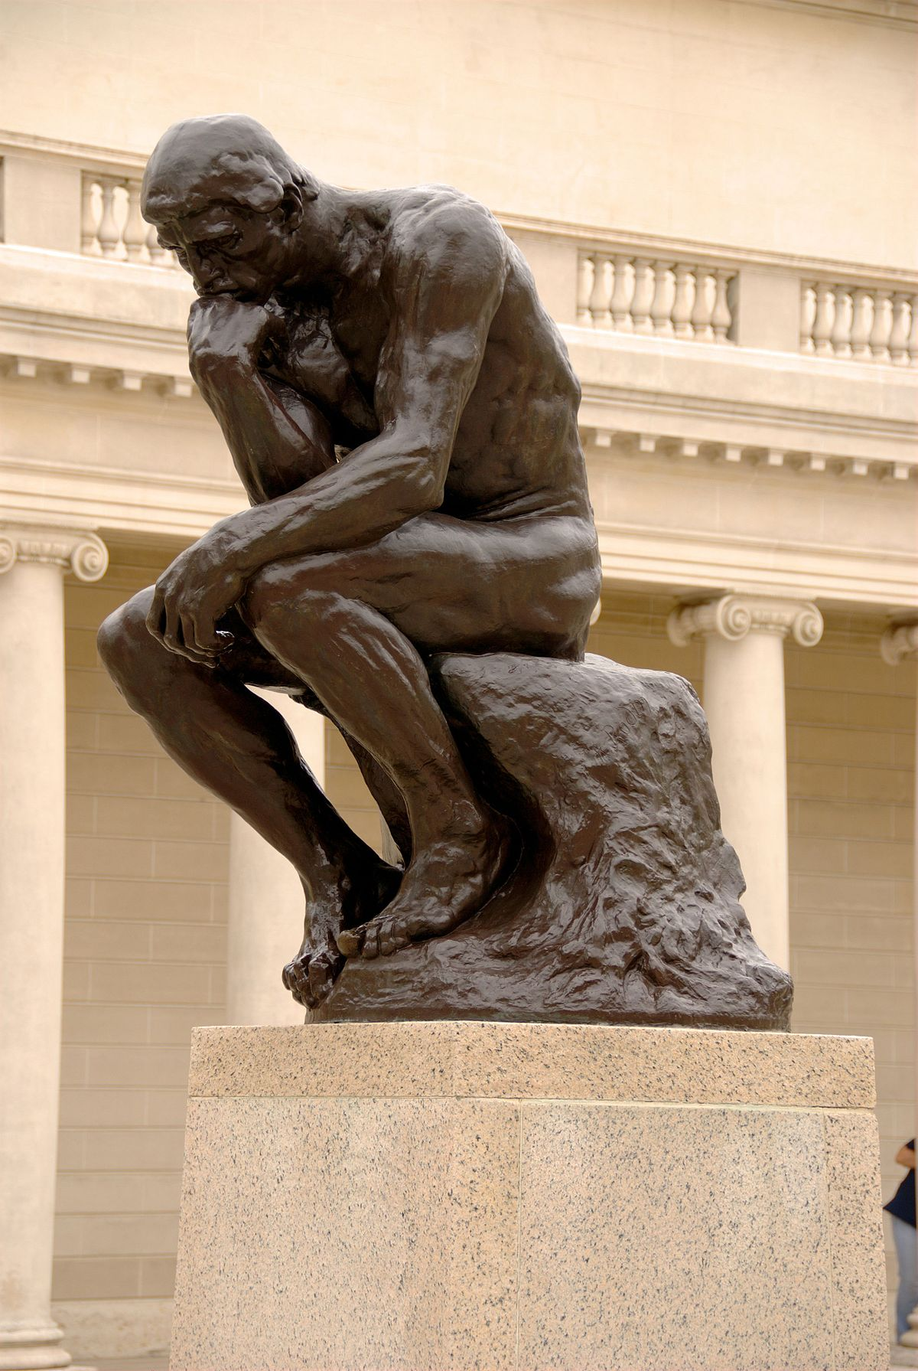
The search for life
Mankind's most puzzling question.
Are we existing in this universe alone?
Do other lifeforms feel we are not evolved enough?
Are we the aliens? Or are they?

Slide 4
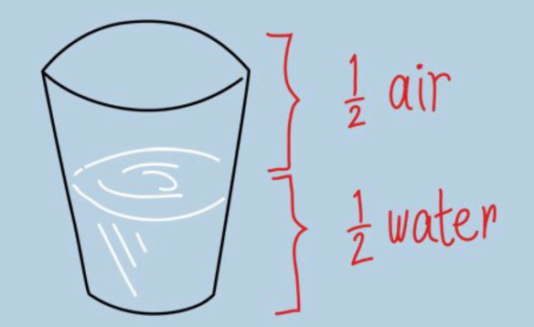
How did we use it?
The data used to feed the algorithms were already solved.
They used the results to compare the time spent computing and how accurate it was to our own computations.

Slide 5
Drawbacks
More resources/time
Lots of data
Trial and error
High Cost
Storage
Error handling
Bias

Slide 6
What were the results??
The main difference in using the algorithm versus old fashioned labor, was that the program was able to come up with EIGHT different stars of interest compared to the human calculations.
The previous data set that was used was 820 nearby stars and was most recently searched through by mankind in 2017 not the machine.

Slide 7
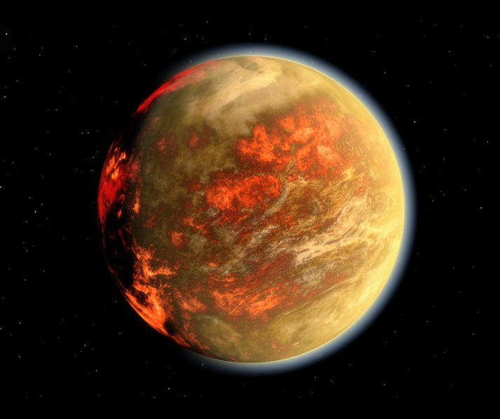
Expanding the search
The study is utilizing machine learning to now expand up to 1 million stars today!!
Techniques
Radio signals
Searching for shadows
Tiny movements
Old fashioned pictures

Slide 8
Sources
https://www.sciencedaily.com/releases/2023/01/230130130512.htm
https://www.javatpoint.com/applications-of-machine-learning
https://www.aplustopper.com/advantages-and-disadvantages-of-machine-learning/

